Slide 1


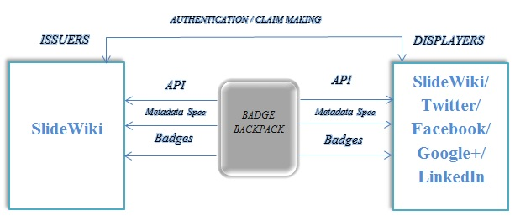
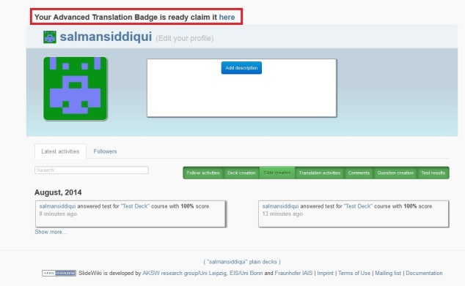
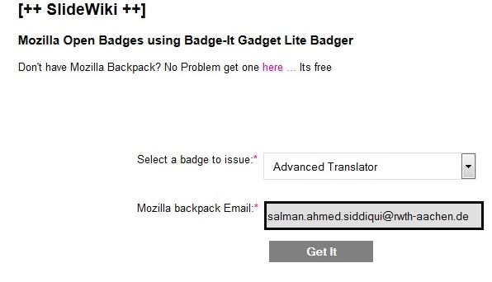
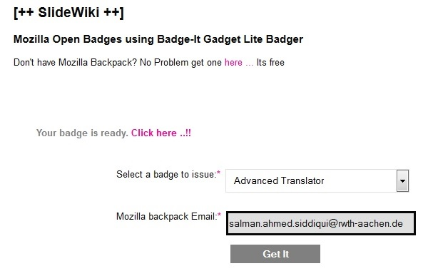
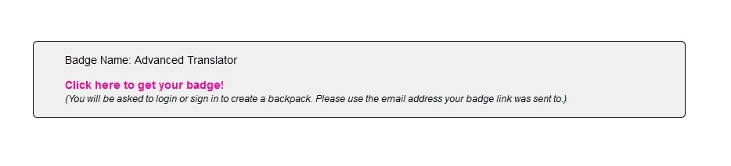
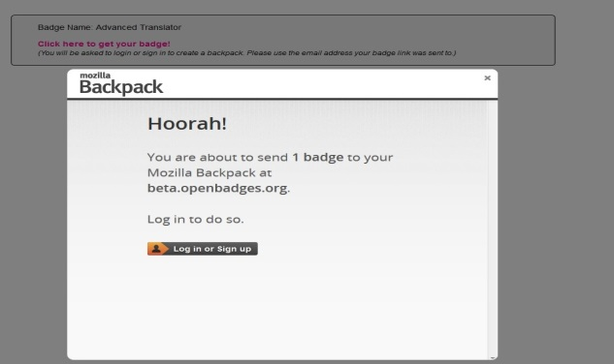
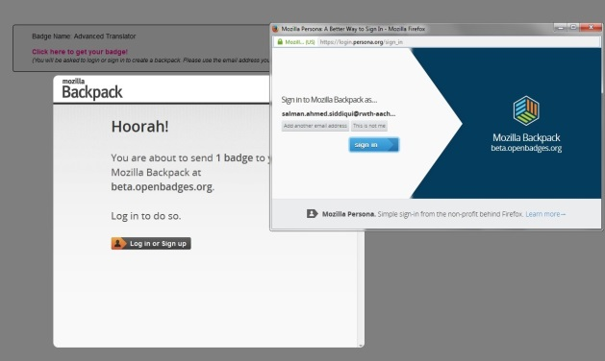
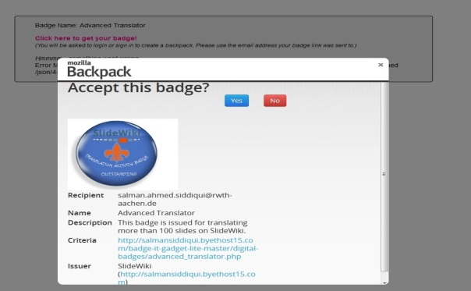
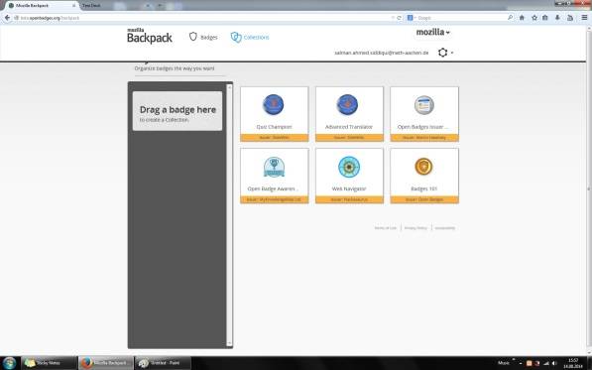
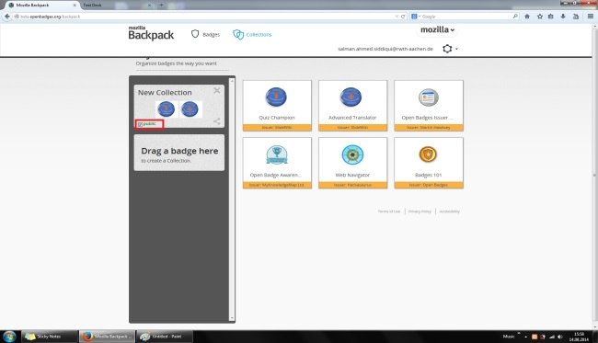
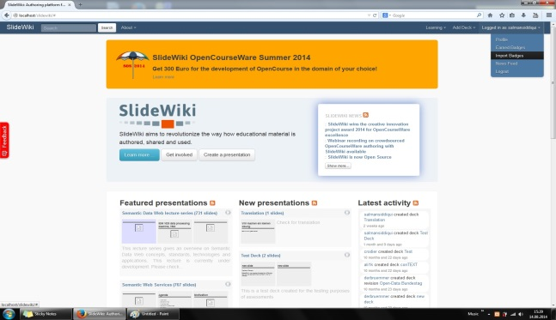
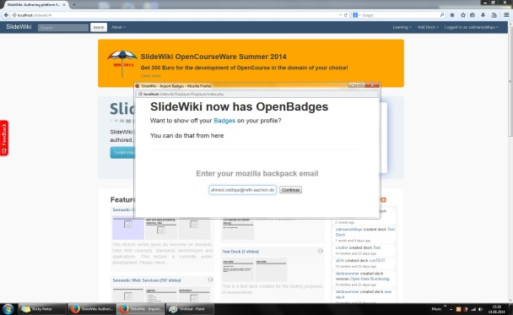
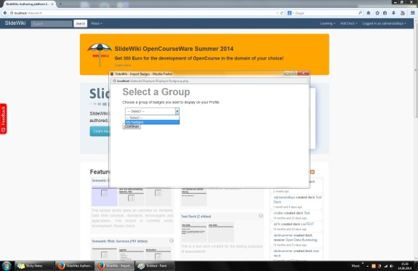
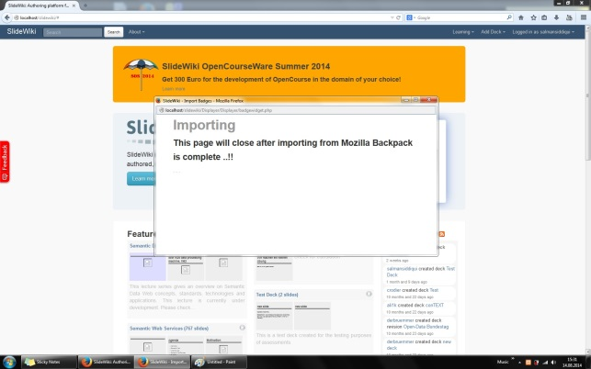
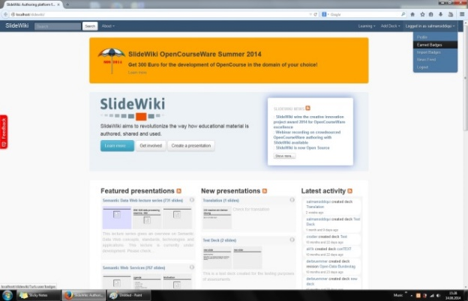
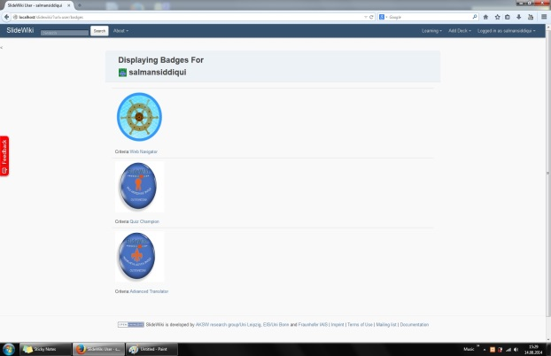

Open Badges for SlideWiki
Setup, About & How-To Access Guide
Team: Amir Ansari Nishananth Baskaran Raghu Palakodety Salman Siddiqui Mentor: Darya Tarasowa
What are Open Badges for SlideWiki?
Digital badges are a validated indicator of accomplishment, skill, quality or interest that can be earned in various learning environments
Mozilla Open Badges project allows badge issuers and developers to build badges, and allows online learners to choose from a number of different pathways for development.
SlideWiki is an open-source OpenCourseWare authoring and e-learning platform available at http://slidewiki.org
Setup:
About:
To deploy Open Badges and a new SlideWiki installation following actions should be performed:
If neccessary, install SlideWiki from https://bitbucket.org/ansari079/slidewiki (requirements and guide is available)
Install Mozilla Open Badges APIs from https://github.com/Achievery/badge-it-gadget-lite (requirements and guide is available)
How Open Badges work?
Issuer makes a Badge available to the users (Earners) of their website .
When awarded the badge, an Earner sends it to her Mozilla Backpack.
Issuer API pushes the badge from Issuer to the Backpack.
In the Mozilla Backpack, users can choose to display the Badges anywhere on the Web.
Displayer API pulls Badges from the Backpack to the chosen Displayer.
Definitions, Concepts and Tools:
Issuer - Who issues a Badge.
Earner - Who earns a Badge.
Displayer - Who displays a Badge.
Mozilla Backpack - Badge Storage and Management Interface.
Issuer API - script to send a badge to Mozilla Backpack.
Displayer API - script for displaying badges.
Architecture:
Implementation:
Open Badges in SlideWiki are implemented for:
Self-Assessment Activity
Translation Activity
SlideWiki Interface updates:
Badge Description Menu
Earned Badges Menu
Import Badges Menu
How to Use:
Interfaces:
Self-Assessment Activity:
Take an assessment test on SlideWiki.org.
Pass the assessment test with 100% score.
Assessment questions must be created by others, not by you!
Congratulations, you own a self-assessment badge!
Input your Mozilla Backpack id and push the badge.
In Mozilla Backpack, group the badges you want to display
Display the group of badges in SlideWiki.
User is asked to claim a Translation Badge
User is asked to input Mozilla Backpack ID
Badge is ready for the export
User is redirected to her Mozilla Backpack
Mozilla Backpack login page
Check Mozilla Backpack credentials
Verify/Accept the badge
Managing Mozilla Backpack Collections
Export of Badges into Mozilla Backpack
Translation Activity:
Finish a Slide translation by editing the machine-translated text on SlideWiki.org.
Do this for at least 50 slides to get the Basic Badge.
Do this for at least 100 slides to get the Intermediate Badge.
Do this for more than 100 slides to get the Advance Badge.
See the notification about how to claim the Badges in your profile page.
Making a group of Badges public
Import of Badges into SlideWiki
Enter Mozilla Backpack credentials
Select a Badge group
Badges are successfully imported!
Display Earned Badges
Displaying Badges
Import of Badges into SlideWiki
EIS
Enterprise
Information Systems

